Slide 1

GIT 101
Learn the basics of source control

Slide 2
History
As with many great things in life, Git began with a bit of creative destruction and fiery controversy.
The Linux kernel is an open source software project of fairly large scope. For most of the lifetime of the Linux kernel maintenance (1991–2002), changes to the software were passed around as patches and archived files. In 2002, the Linux kernel project began using a proprietary DVCS called BitKeeper.
In 2005, the relationship between the community that developed the Linux kernel and the commercial company that developed BitKeeper broke down, and the tool’s free-of-charge status was revoked. This prompted the Linux development community (and in particular Linus Torvalds, the creator of Linux) to develop their own tool based on some of the lessons they learned while using BitKeeper. Some of the goals of the new system were as follows:
Speed
Simple design
Strong support for non-linear development (thousands of parallel branches)
Fully distributed
Able to handle large projects like the Linux kernel efficiently (speed and data size)
https://git-scm.com/book/en/v2/Getting-Started-A-Short-History-of-Git

Slide 3

About
https://git-scm.com/
Branching and Merging
Small and Fast
Distributed
Data Assurance
Staging Area
Free and Open Source

Slide 4

Branching and Merging

Slide 5
Small and Fast
Git is fast. With Git, nearly all operations are performed locally, giving it a huge speed advantage on centralized systems that constantly have to communicate with a server somewhere.
Git was built to work on the Linux kernel, meaning that it has had to effectively handle large repositories from day one. Git is written in C, reducing the overhead of runtimes associated with higher-level languages. Speed and performance has been a primary design goal of the Git from the start.
One place where Git is slower is in the initial clone operation. Here, Git is downloading the entire history rather than only the latest version.

Slide 6
Distributed
One of the nicest features of any Distributed SCM, Git included, is that it's distributed. This means that instead of doing a "checkout" of the current tip of the source code, you do a "clone" of the entire repository.
Multiple Backups This means that even if you're using a centralized workflow, every user essentially has a full backup of the main server. Each of these copies could be pushed up to replace the main server in the event of a crash or corruption. In effect, there is no single point of failure with Git unless there is only a single copy of the repository.
Centralized Workflow (next slide)

Slide 7
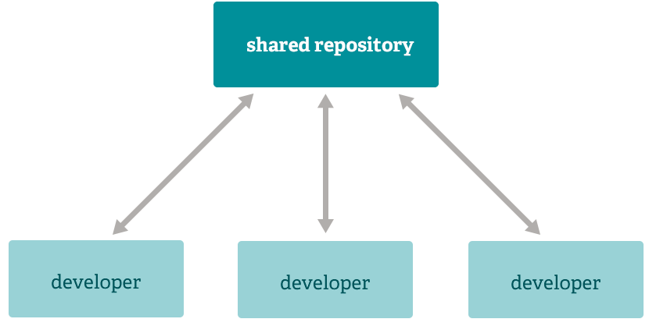
Centralized Workflow

Slide 8
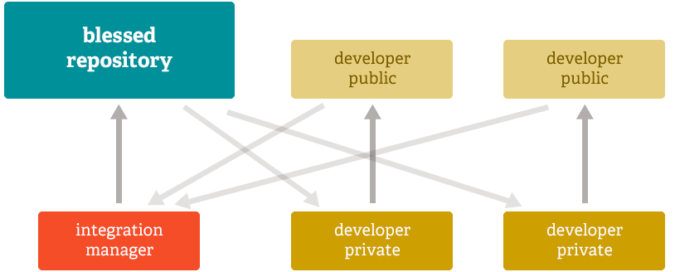
Integration Manager Workflow

Slide 9
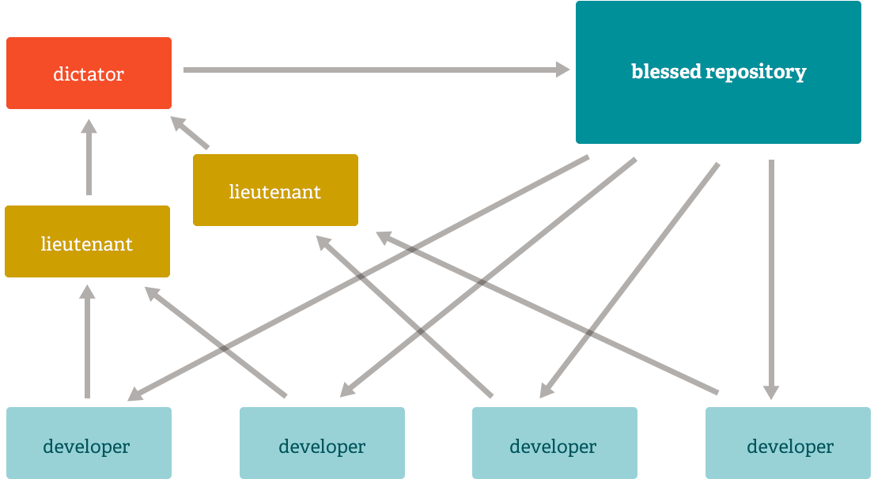
Dictator and Lieutenants Workflow

Slide 10


Slide 11
Config
Configure user information for all local repositories
Sets the name you want attached to your commit transactions
$ git config --global user.name "[name]"
Sets the email you want attached to your commit transactions
$ git config --global user.email "[email address]"
Enables helpful colorization of command line output
$ git config --global color.ui auto

Slide 12
Create repo
Turns an existing directory into a new Git repository inside the folder you are running this command:
$ git init
Link the local repository to an empty GitHub repository using the following command (Specifies the remote repository for your local repository. The url points to a repository on GitHub):
$ git remote add origin [url]
Clone (download) a repository that already exists on GitHub, including all of the files, branches, and commits:
$ git clone [url]

Slide 13
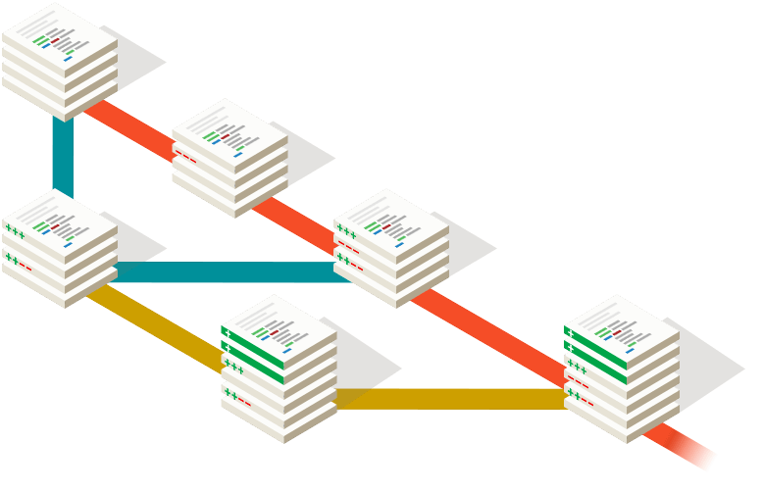
First commit
Snapshots the file in preparation for versioning
$ git add [file]
Records file snapshots permanently in version history
$ git commit -m "[descriptive message]"
Updates your current local working branch with all new commits from the corresponding remote branch on GitHub:
$ git pull
(git pull is a combination of git fetch and git merge)

Slide 14
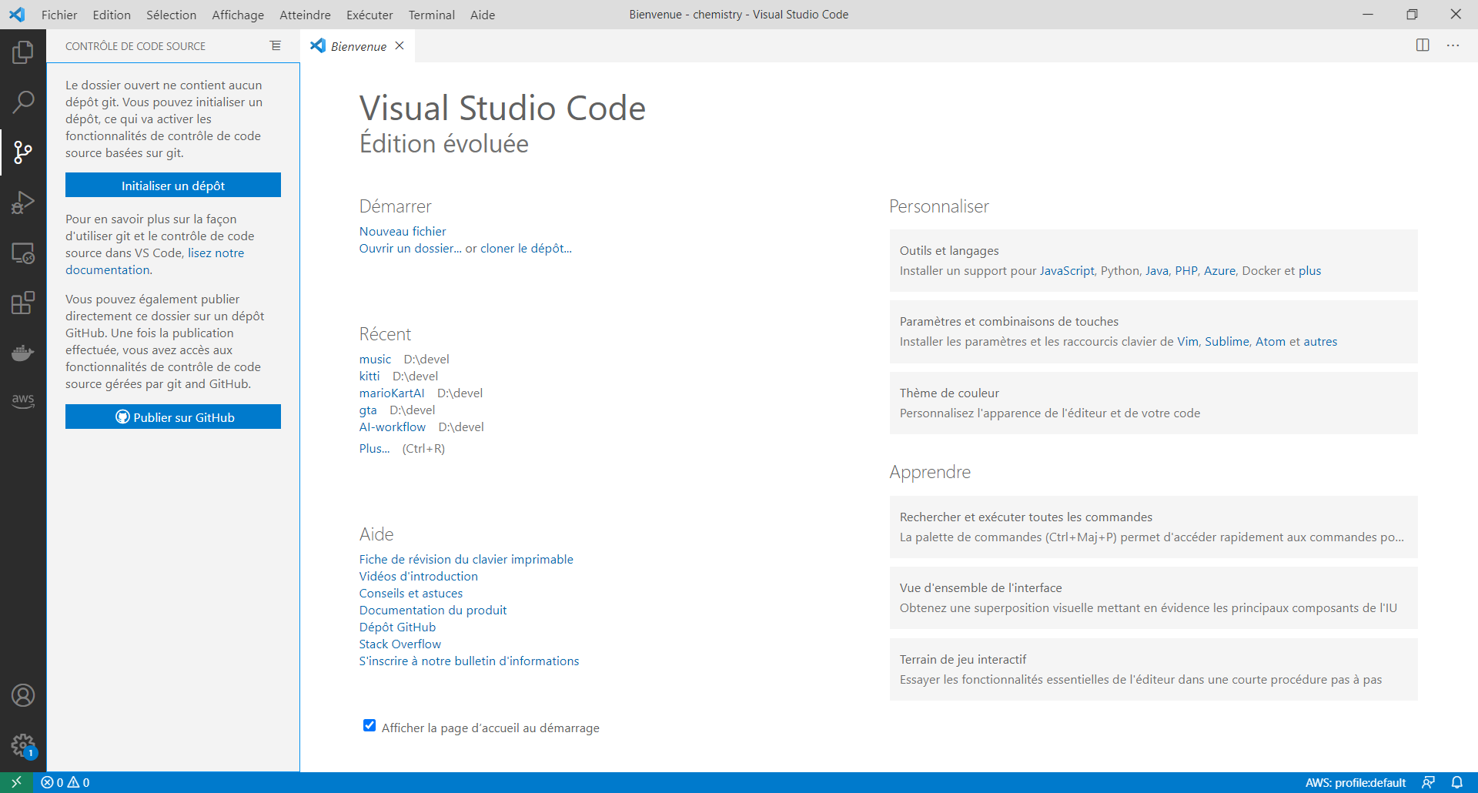

Slide 15
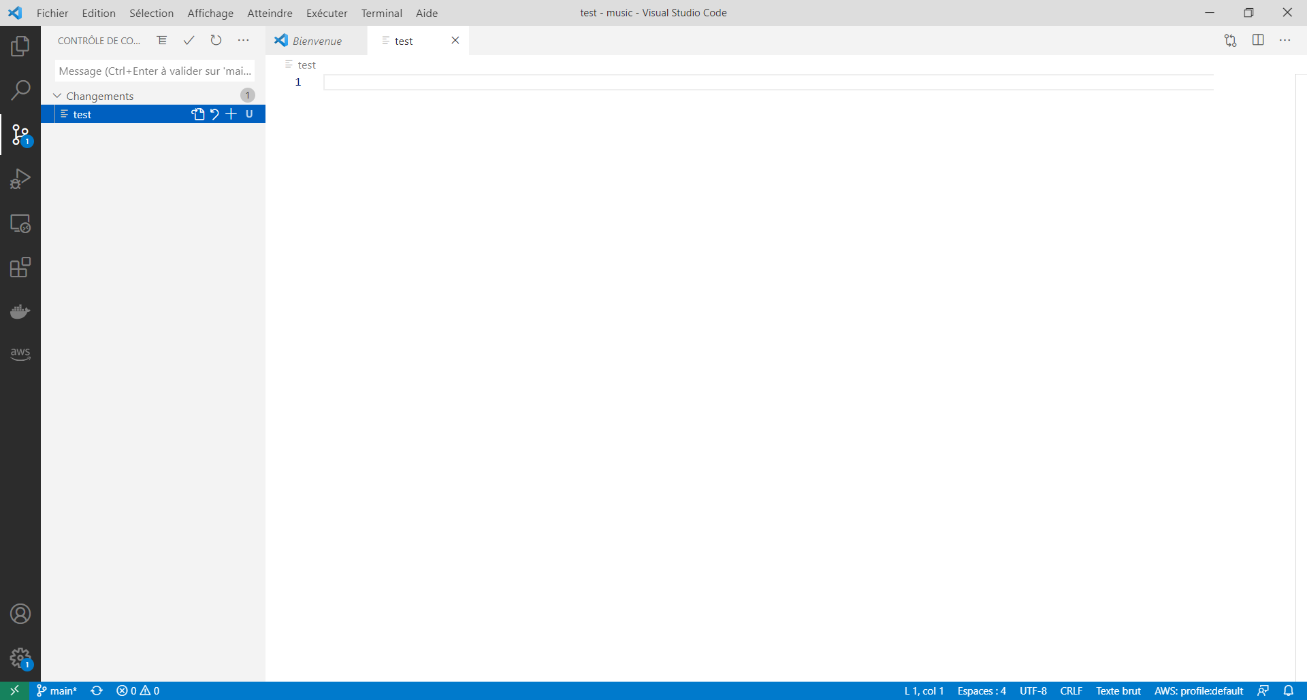
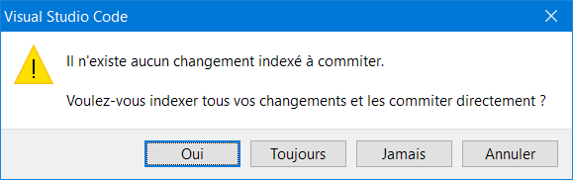

Slide 16
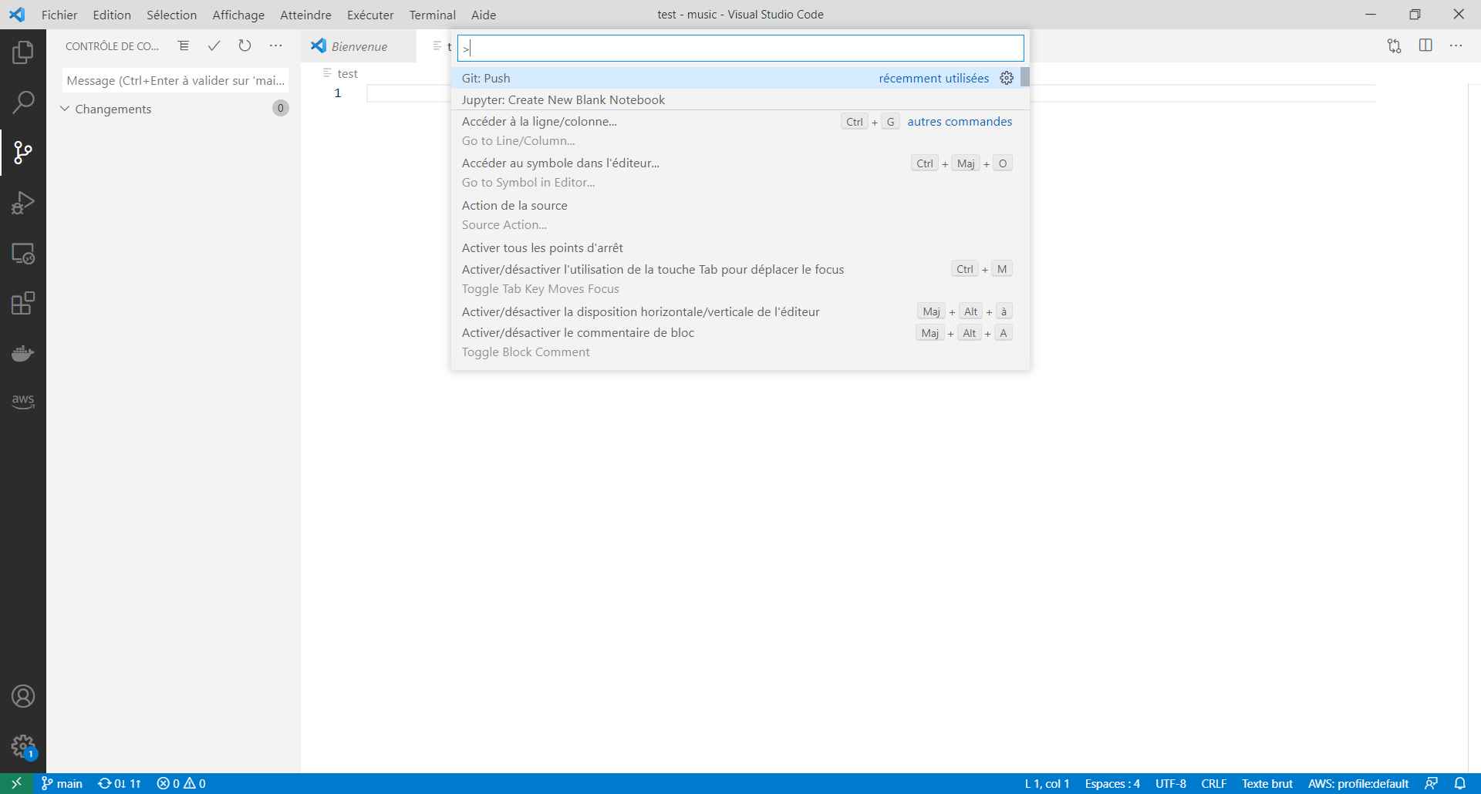

Slide 17
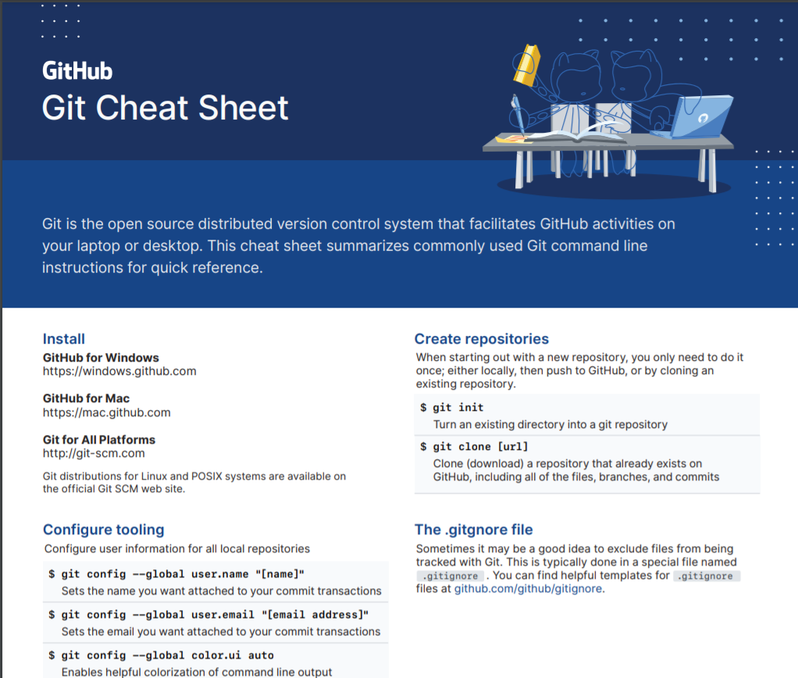
Resources
https://try.github.io/
GitCheatSheet_issue#2366_102019-V5 (github.com)
GitHub Git Cheat Sheet - GitHub Cheatsheets
7 Best Git & Github Online Courses for Beginners to Learn in 2021 | Medium

